Slide 1





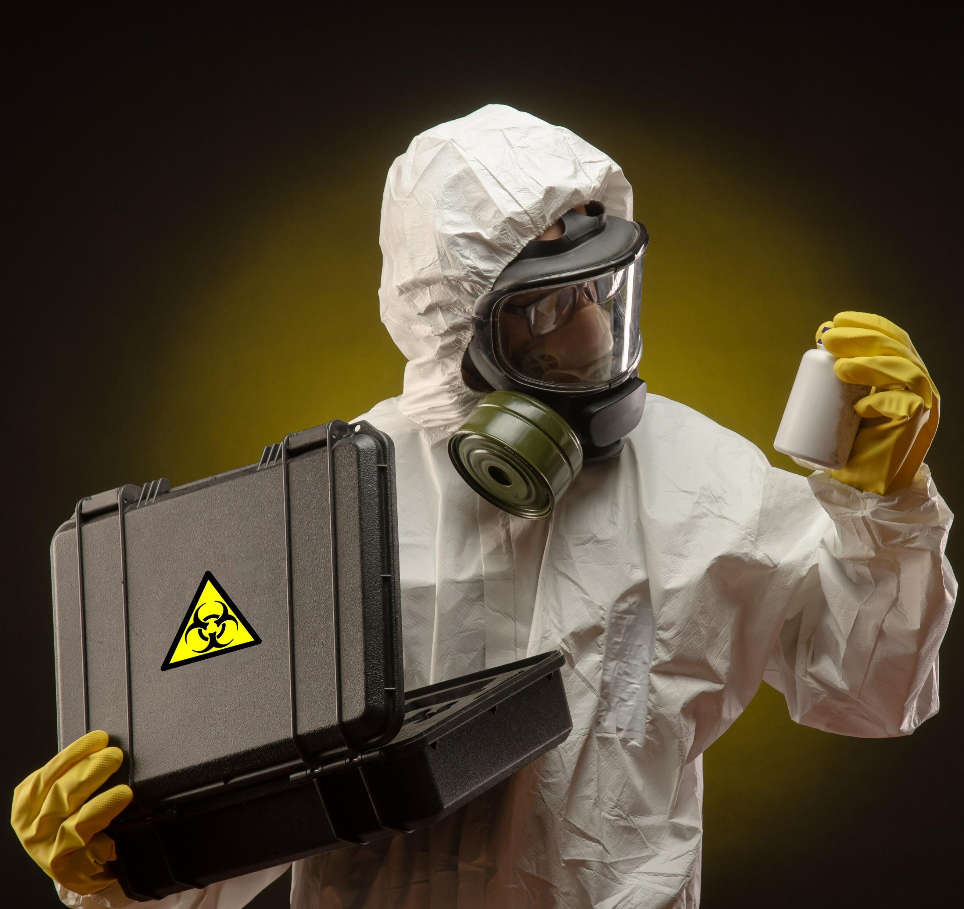
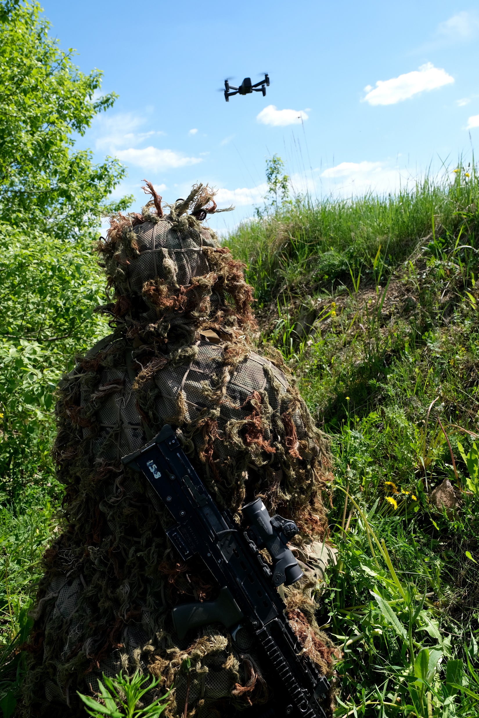

Counter-Threat Symposium
https://www.adsgroup.org.uk/events-list/counter-threat-symposium-2022
Crown copyright 2021
Counter-Threat Day 1
Threat & Context
Counter-Threat Day 2
Policy & Capability
Counter-Threat Day 3
Procurement
CBRN UK Industry Group covering:
Chemical, Biological, Radiological, Nuclear threats
Detection, PPE, Information Management Training and Counter-Measures
DPAC Industry Group covering:
Providers of drone platform & payload
Drone supply chain & services
Counter-drone capabilities
C-EO UK Industry Group covering:
IEDs, Minefields
Explosive Ordnance and Bombs
Training, Detection and counter-Measures
8th-10th Nov 2022
40+ Table-Top Exhibition
Sponsorship packages available
Contact:
Allison.Spyer@adsgroup.org.uk
+44 (0) 20 7091 1120
Contains public sector information licensed under the Open Government Licence v3.0

